Slide 1
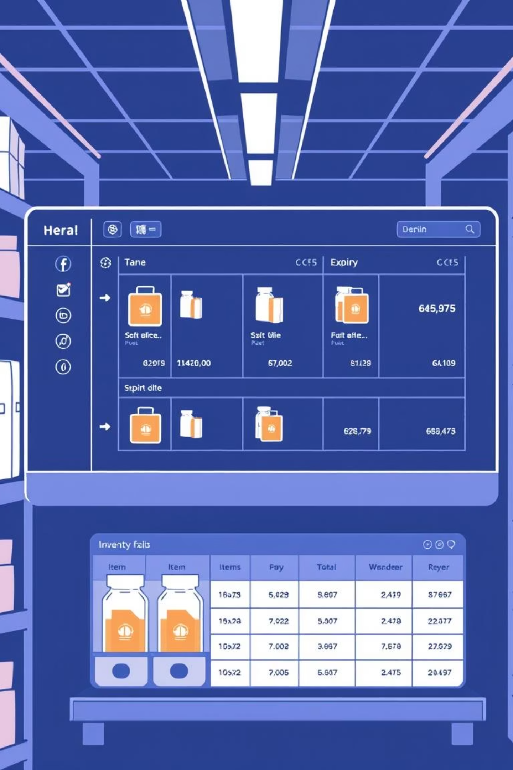
ExpirySync
Smart Inventory Expiry Management System
A Full-Stack Java DSA Educational Project
Presented By: Rubab Fatima (Roll # 28) Aneesa Sultan (Roll # 20) Maria Atta (Roll # 01)

Slide 2

Executive Overview: ExpirySync
ExpirySync is an innovative full-stack educational project designed to illustrate fundamental Data Structures & Algorithms (DSA) within a practical, real-world inventory expiry management system.
Leveraging a Java backend and an intuitive web frontend, ExpirySync vividly demonstrates how essential DSA concepts—such as stacks, queues, priority queues, and various sorting and searching algorithms—function in a live application.

Slide 3

The Inventory Management Challenge
Managing perishable inventory presents significant hurdles for businesses:
Missed Expired Items
Lack of Prioritization
Failure to detect and remove expired products leads to waste and potential health risks.
Urgent or near-expiry products often aren't flagged, resulting in avoidable losses.
Inefficient Manual Tracking
Reliance on manual processes is prone to human error, consuming valuable time and resources.
Traditional inventory systems frequently fall short in effectively integrating and applying DSA concepts to overcome these issues.

Slide 4





Project Objectives: Bridging Theory and Practice
ExpirySync aims to achieve several key educational and practical goals:
Real-World DSA Application
Implement core DSA concepts within a functional system.
Visualizing DSA
Provide clear visual representations of Stack, Queue, and Priority Queue operations.
Algorithm Demonstration
Showcase sorting and searching algorithms in action.
Complete Academic Project
Deliver a robust, full-stack project suitable for academic submission.
Enhanced Understanding
Deepen students' conceptual grasp of DSA principles.

Slide 5






System Architecture & Technology Stack
System Flow
Technology Stack
User Browser
Backend
Java 11
HttpServer (built-in)
Web Frontend
Maven
Gson
Java HttpServer
Frontend
HTML, CSS, JavaScript
DSA Logic Layer
Font Awesome
LocalStorage
This layered approach ensures clear separation of concerns and robust functionality.
Note: This project intentionally avoids external databases or frameworks to emphasize core DSA and Java principles.

Slide 6





Core Data Structures in Action
ExpirySync intelligently employs various data structures to manage inventory effectively:
Stack (LIFO)
Queue (FIFO)
Tracks recently added products for quick access.
Processes expired products in the order they become expired.
Operations: Push, Pop, Peek
Operations: Enqueue, Dequeue
Time Complexity: O(1)
Time Complexity: O(1)
Priority Queue (Min-Heap)
ArrayList
Manages urgent items based on their expiry proximity.
Serves as the primary product storage for all inventory items.
Operations: Insert, Extract Min
Flexible storage
Time Complexity: O(log n)
Dynamic resizing
Each structure is strategically applied to solve a specific inventory management challenge.

Slide 7
Priority Queue Levels for Urgent Products
The Min-Heap based Priority Queue ensures critical items are addressed first, preventing waste and optimizing stock rotation.
0
Expired: Products that have already passed their expiry date.
1
Critical: Products expiring within 3 days.
2
Urgent: Products expiring within 7 days.
3
Normal: Products with more than 7 days until expiry.
This granular prioritization allows the system to alert users and facilitate timely action, such as promotions or immediate removal for disposal.

Slide 8

Algorithms for Efficiency and Analysis
ExpirySync integrates various sorting and searching algorithms to ensure efficient data handling and retrieval.
Sorting Algorithms
Searching Algorithms
Quick Sort
Linear Search
Efficiently sorts products by expiry date for easy overview.
Simple method for finding specific products in an unsorted list.
Merge Sort
Binary Search
Used for sorting products based on their priority level.
Efficiently locates products in a sorted list (e.g., by ID or name).
Bubble Sort
Included for educational purposes to demonstrate basic sorting mechanics.

Slide 9





Key Features & Educational Impact
ExpirySync is packed with features designed to be both functional and highly educational.
Product Management
Expiry Alerts
Urgent Item Detection
Seamlessly add and remove products from inventory.
Automated notifications for approaching expiry dates.
Identifies and highlights products needing immediate attention.
DSA Visualizations
Dashboard Statistics
Interactive visual aids for understanding DSA concepts.
Provides an overview of inventory health and key metrics.
Educational Value
This project serves as an invaluable tool for students to connect DSA theory with real-world applications, offering full-stack exposure using Java and aiding in exam preparation, labs, and viva sessions.

Slide 10

Conclusion & Thank You
ExpirySync stands as a testament to the power of Data Structures and Algorithms in solving practical problems.
Core DSA Demonstrated
Real-World Application
Successfully implements and showcases essential DSA concepts.
Applies algorithms in relevant inventory management scenarios.
Academic Ready
Enhanced Learning
Delivers a clean, comprehensive project suitable for academic use.
Fosters deeper understanding through interactive visualization.
Project Details:
Project: ExpirySync
Subject: Data Structures & Algorithms
Technology: Java + Web (HTML, CSS, JavaScript)

